Slide 1


SAP Full-Stack Developer training
ABAP on HANA, UI5 & Fiori, Analytics with OData
Anubhav Oberoy
Day – 8

Slide 2

Agenda – Day 8
Fiori System architecture
Fiori App Ref. Library
Fiori App Implementation
ABAP Deployment
Pre-requisites for Standard Fiori App
SAP Fiori Standard App Implementation
Relationship between Front-End Components
--Break--
What SAP Fiori element
Advantage of Fiori Elements
Annotation
Create List Report Fiori Elements App
Git Hub

Slide 3
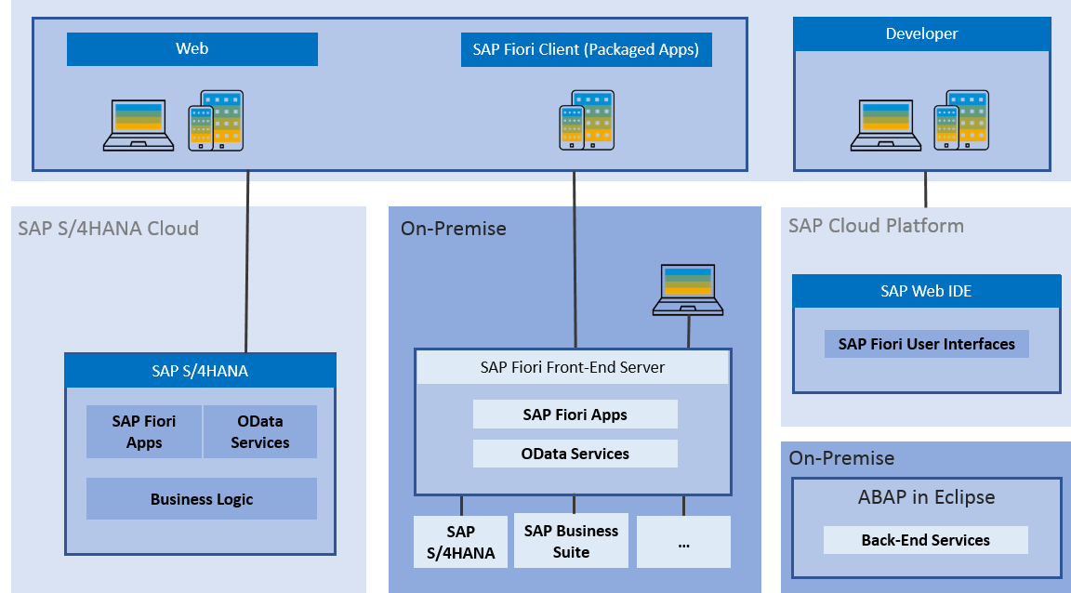
Fiori System Architecture
The SAP Fiori architecture introduces the high-level architecture of SAP Fiori.
The SAP Fiori apps are built with SAPUI5 technology for web applications and iOS native and can be used on smartphones, tablets, and desktop computers.
The SAP Fiori launchpad is used to launch and run the apps.

Slide 4
Fiori App Ref. Library
It’s a library which tells us all the list of Fiori Apps and Non-Fiori Apps offered by SAP as standard.
These apps are grouped under solutions and we can search particular app(s) based on different criteria
https://fioriappslibrary.hana.ondemand.com/sap/fix/externalViewer/
Total Apps – 11628
Fiori Apps - 2107
By Name, description
By User function
By Id & Product
By Functional
Area – Finance, Sales, Marketing, Procurement
By Role
Different Search Criteria

Slide 5
Two types of SAP-Fiori app implementations
Standard Apps
Implementation of those business apps, which are released by SAP
These are categorized as Transnational, Fact-sheets and Analytical apps etc.
Customized Apps
As per business requirement, a complete custom fiori app can be implemented.
Customized App is been hosted on SAP-Fiori server (front-end system).
It integrates with SAP or Non-SAP system.

Slide 6

ABAP Deployment
Step1: Open the terminal in BAS and go to your project folder.
Step2: Write command ui5 init and press enter
Step3: Write command ui5 build and press enter
Step4: Write command abap-deploy and press enter
Step5: Specify the source folder path for deployment … ./dist
Step6: Select a target ABAP system … http://103.207.171.202
Step7: Enter the ABAP system client number …
Step8: Enter a username …
Step9: Enter a password …
Step10: Enter an application name …
Step11: Enter a description for the application …
Step12: Enter a package for the deployed application … $TMP

Slide 7
Pre-requisites for Standard Fiori App
SAP ECC Server (Back-end)
SAP Fiori Server (Front-end)
SAP Fiori Launchpad Url:
http://<host>:<port>/sap/bc/ui5_ui5/ui2/ushell/shells/abap/FioriLaunchpad.html
tcode: /n/ui2/flp
SAP Fiori Designer Url:
http://<host>:<port>/sap/bc/ui5_ui5/sap/arsrvc_upb_admn/main.html
tcode: /n/ui2/flpd_conf
Important T-codes:
SrNo | T-code | Description
1 | SICF (Path: /sap/bc/ui5_ui5/sap/) | UI5 Application Path
2 | SICF (Path: /sap/opu/odata/sap/) | Odata Service Path
3 | /n/iwfnd/maint_service | Odata Service Registration
4 | /n/UI2/SEMOBJ_SAP | Semantic objects by SAP
5 | /n/iwfnd/error_log | Error Log
6 | LPD_CUST | Launchpad Role
7 | PFCG | PFCG Role
Trainer: Anubhav Oberoy

Slide 8
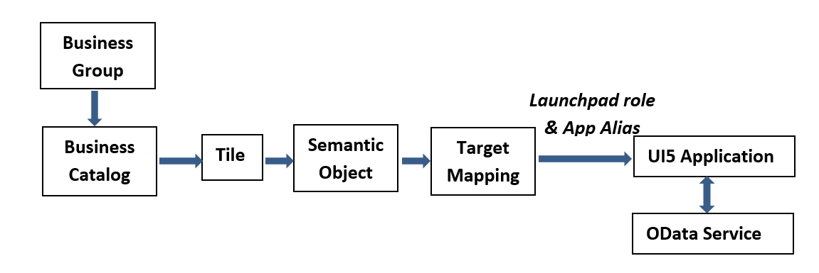
Relationship between Front-End Components
Trainer: Anubhav Oberoy

Slide 9

Break
Trainer: Anubhav Oberoy

Slide 10
SAP Fiori Element
SAP Fiori elements is a framework that comprises the most commonly used floorplan templates and is designed to:
Speed up development by reducing the amount of frontend code needed to build SAP Fiori apps.
Drive UX consistency and compliance with the latest SAP Fiori design guidelines.
Each version of SAP Fiori elements supports a different version of OData (Open Data Protocol), as their names indicate:
SAP Fiori elements for OData version 2 (V2)
SAP Fiori elements for OData version 4 (V4)
Fiori Elements are reusable templates, the main benefit is to:
Reduce the maintenance as there is no need to develop the JS code
Application standardization
Reduce effort in development
Using annotation makes its independent of UI technology
Fiori Apps
Data Source Exposes the OData Service
SEGW Service | CDS View based Service
Trainer: Anubhav Oberoy

Slide 11
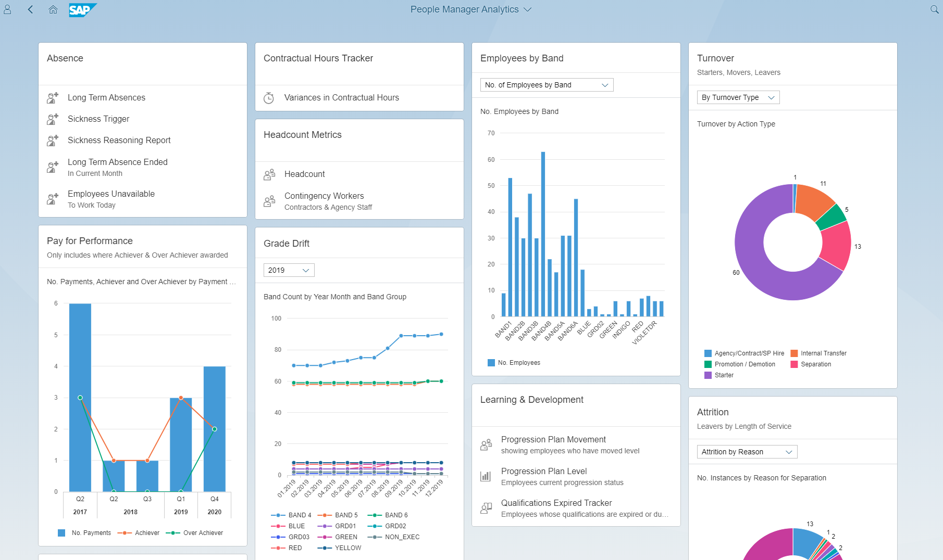
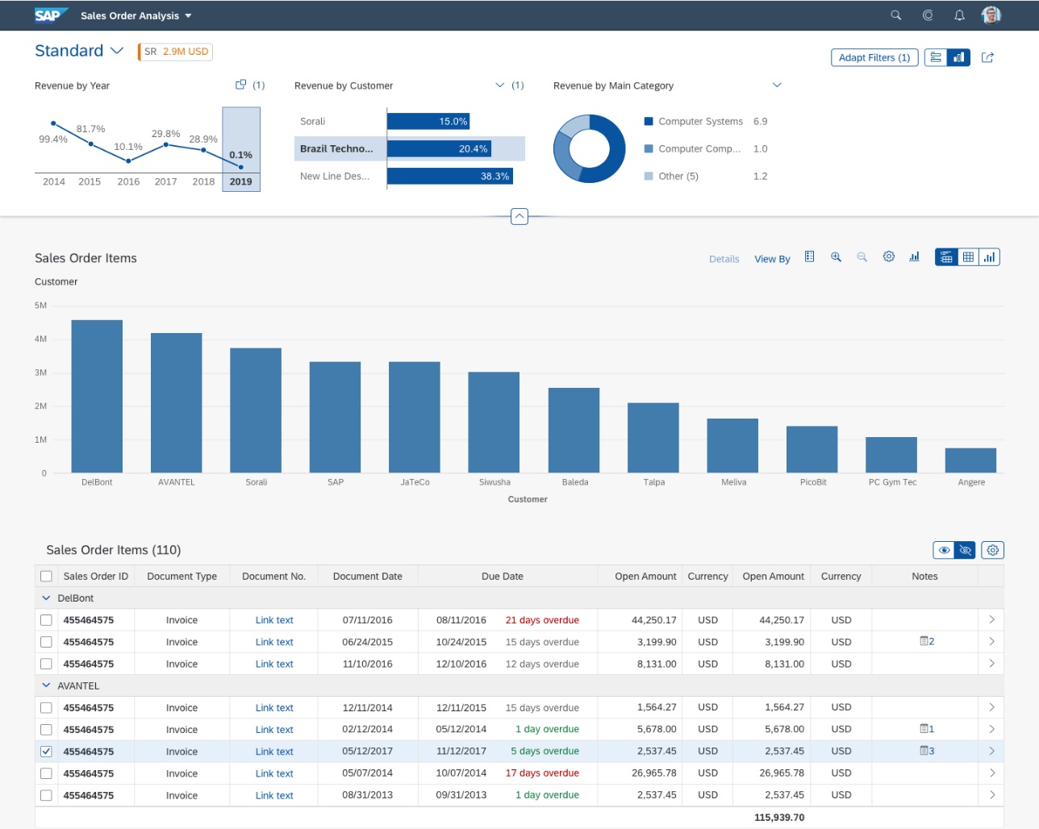
SAP Fiori Element App looks like as:
Trainer: Anubhav Oberoy

Slide 12
Advantage of Fiori Elements
Development efficiency
Best Practices
High development efficiency to cover what 80% of all apps need.
you don’t have to worry about where a particular action button should be placed or how your UI code should be structured or about how navigation between two application should be handled etc.
Advantage
Design consistency
Rapid Development
Predefined floorplans, views, and controllers ensure UI consistency within and across similar apps.
We can productize an application not in months or years but in days and weeks.
Decoupling of UI and business logic
Extensibility
The metadata-driven development model uses semantic annotations and significantly reduces the amount of front-end code.
SAP Fiori Elements is not rigid, rather it’s very flexible and extensible at every layer.

Slide 13
Annotation
Annotation files are usually defined as data sources in manifest. Json.
Semantic business layer which independent of UI the layer
In the dataSources definition of the OData service, you can reference these annotation data sources in the annotations setting.
Metadata annotations can be used to define additional characteristics or capabilities of a metadata element, such as a service, entity type, property, function, action or parameter.
The Fiori has standard elements aps like:
1. List Report
2. OVP – Over view pages
3. ALP – Analytic List page
CDS View : Core Data Service in SAP S/4HANA system, is one best way to push down logic to SAP HANA
Documentation Link: https://help.sap.com/viewer/cc0c305d2fab47bd808adcad3ca7ee9d/7.5.9/en-US/f8af07bb0770414bb38a25cae29a12e9.html
Trainer: Anubhav Oberoy

Slide 14
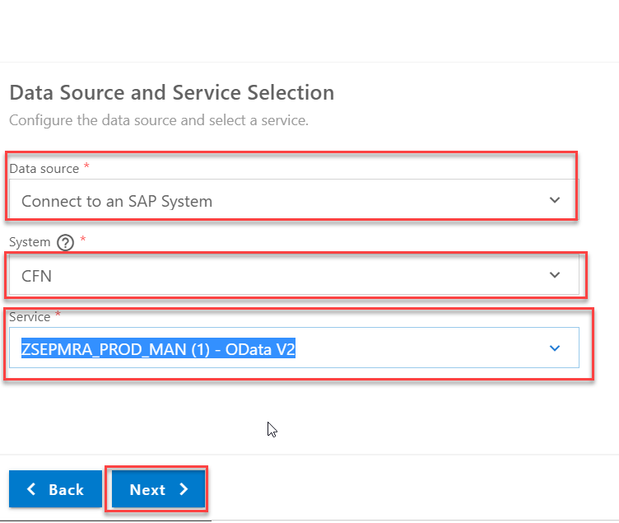
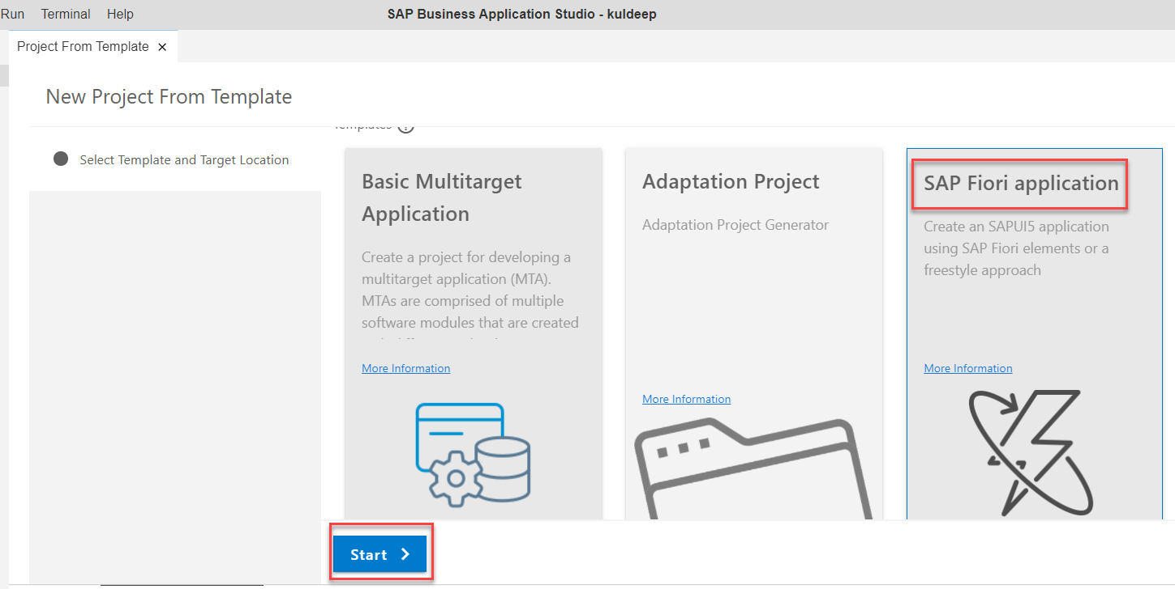
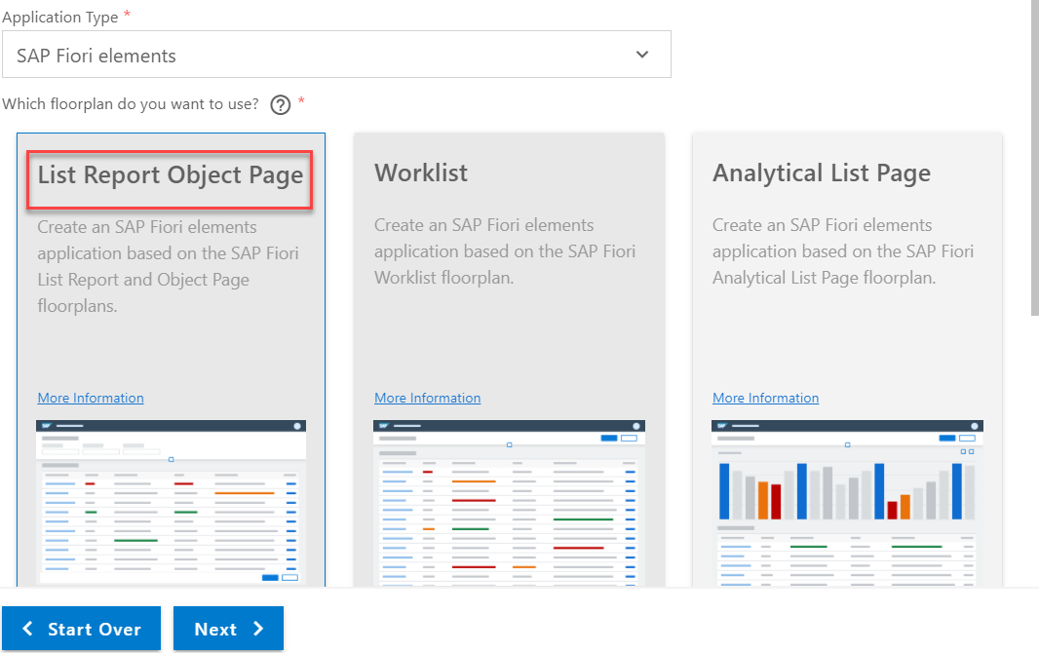
Create List Report Fiori Element App
Go to BAS and go to file section and Create New project from Template and Select SAP Fiori application and click on Start.
Select List Report Object Page
Click on Next
Fill all the mandatory fields
Select the Data Source and System.
Choose the service url :-
ZSEPMRA_PROD_MAN(1)-Odata V2
Trainer: Anubhav Oberoy

Slide 15
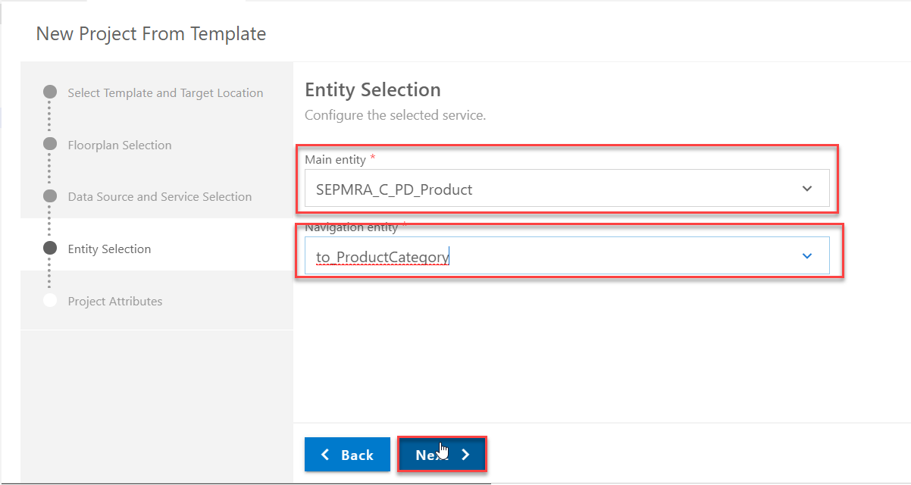
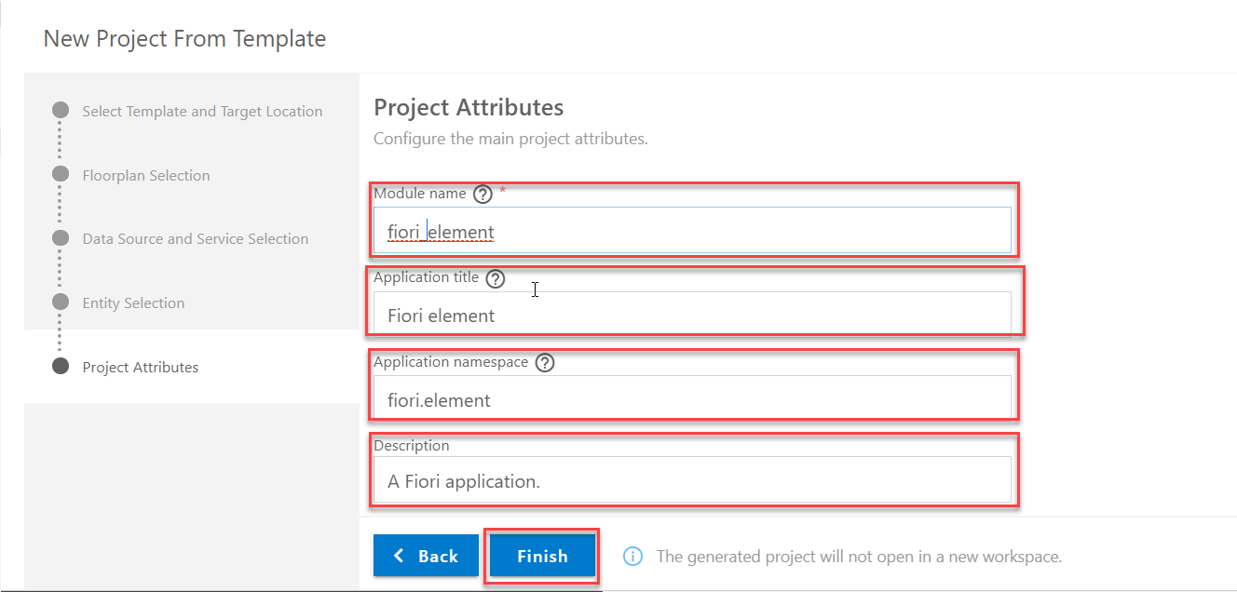
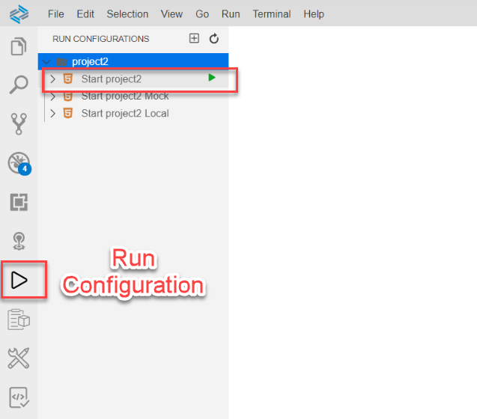
Create List Report Fiori Element App
Entity Selection
Project Attributes
Go to run Configuration and Run project and Open URL in Chrome.
Trainer: Anubhav Oberoy

Slide 16
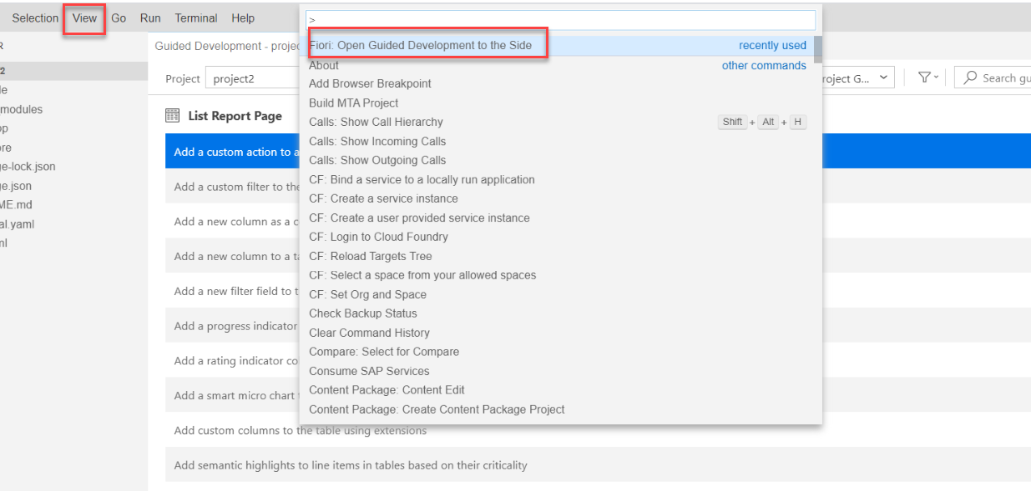
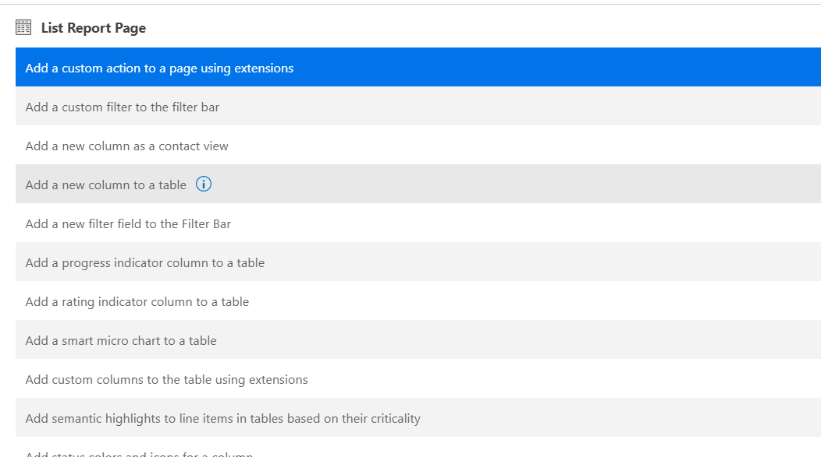
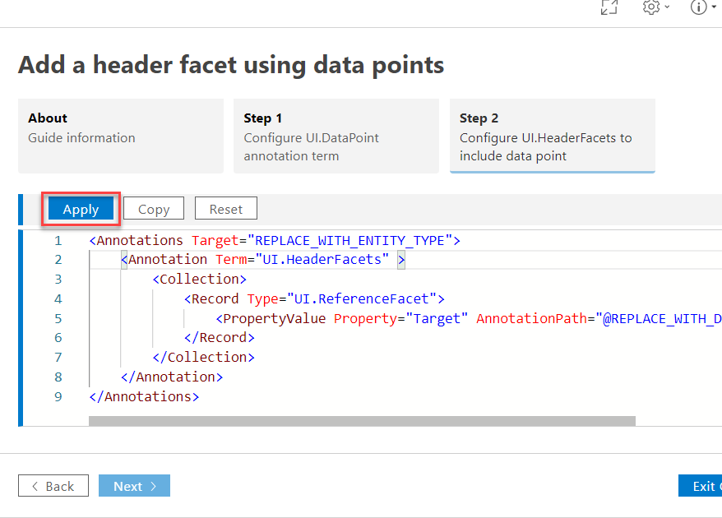
Create List Report Fiori Element App
Add new beauty in project
Go to view button
Search “Fiori open Guided development..”
Choose whatever you want to do in App
Apply this code in your project
Trainer: Anubhav Oberoy

Slide 17
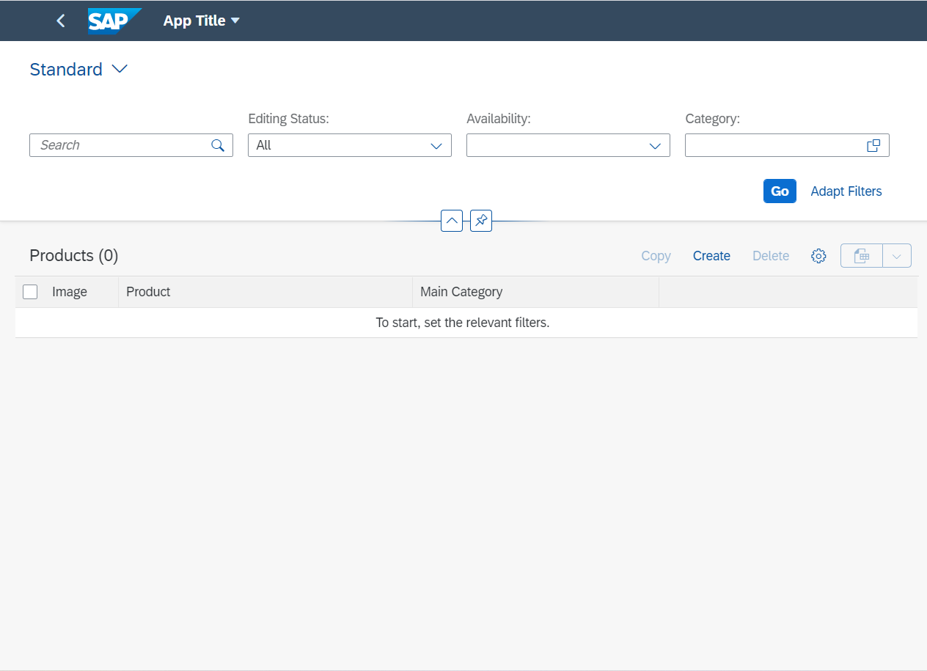
List Report App look like
Fiori Element List reports is one of the standard sap Fiori floorplans which offers features like users can view a large set of items. User can search the relevant items using filters, sorting, and grouping as out of box feature of this floorplan.
Trainer: Anubhav Oberoy

Slide 18
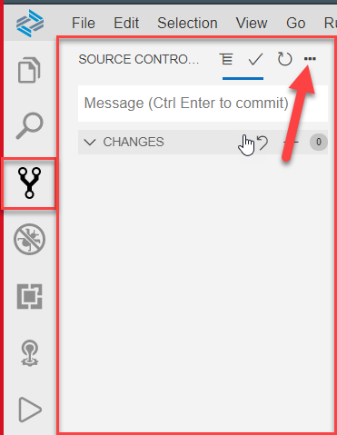
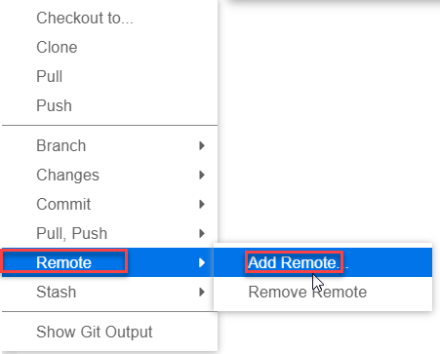
GITHUB
Adding git repo to our project

Slide 19

End of Day 8

Slide 20

Questions

Slide 21

Anubhav Oberoy

Slide 22


We’re committed to empower you to be
Most Desirable Resource
through powerful training solutions.
We build the workforce of the future.
250+
Corporate Clients
30,000+
Learners Trained
25000+
Learners Placed
FREE WEBINARS
Sign up for free webinars with industry experts every fortnight!
Enroll Now!
Contact us today!
https://anubhavtrainings.com/

Slide 23




More from AnubhavTrainings.com

Slide 24
Title
Content

